Slide 1
Front End Engineering-I Project
Team Details:
1) Ishit Sharma -2310991851
2) Jagjot Singh-2310991852
3) Jai Anand-2310991853
Faculty Coordinator:Dr Bhisham Sharma
:
Chitkara University Institute of Engineering and Technology,
Chitkara University, Punjab

Slide 2
Table of Contents
Introduction
Problem Statement
Technical Details
Key Features
Project Highlights
Bonus Feature(optional)
Conclusion
References/Links used

Slide 3
Introduction
Social Media Dashboard
Made by: Ishit Sharma , Jagjot Singh, Jai Anand
Overview:
The Social Media Dashboard project is a comprehensive digital tool designed to simplify and enhance the management and analysis of social media activities for businesses, influencers, and individuals. In today's digital age, managing multiple social media platforms and tracking their performance is crucial for achieving online success and making informed decisions. This project aims to streamline these processes by providing a centralized, user-friendly dashboard for monitoring, analyzing, and optimizing social media presence.

Slide 4
Problem Statement
"Social Media Dashboard" aims to address the following problem:
Background Information and Research:
In recent years, the use of social media has become an integral part of our personal
and professional lives. Individuals, businesses, and organizations utilize multiple social media
platforms to connect with their audiences, promote products or services, and share content.
However, managing multiple social media accounts efficiently has become increasingly
challenging due to several factors:
1) Platform Proliferation: The number of social media platforms has grown significantly,
each with its own unique features,algorithms, and analytics tools. This makes it difficult
for users to keep track of their performance and engagement across all platforms.
2) Data Overload: Monitoring and analyzing the vast amount of data generated on social media,
such as likes, comments, shares, and impressions, can be overwhelming. Without a centralized
tool, users may miss important insights and trends.
3) Inconsistent Branding: For businesses and organizations, maintaining a consistent
brand image across different social media platforms is crucial. Failing to do so
can dilute brand identity and impact customer perception.
4) Time-Consuming Tasks: Posting content, scheduling updates, responding to messages,
and analyzing performance metrics require substantial time and effort when managing
multiple accounts individually. This can lead to inefficiencies and decreased productivity.

Slide 5
Technical Details
Technology Used:
- Front-end: HTML CSS and Javascript
- Back-end: Fetching Data From ython
Hosting & Deployment:
-Flask
-Node.js
Security Measures:
-User authentication system
-Data encryption
-Regular security audits
-Using HTPS

Slide 6
Key Features
•User Engagement: Increasing user engagement by providing a platform for communication, sharing, and interaction.
•Content Discovery: Facilitating content discovery through trending topics and personalized feeds.
•Connection Building: Helping users build and maintain connections with friends and communities.
•Information Access: Offering a centralized source for news, updates, and event information.
•User Control: Giving users control over their data privacy and content sharing.

Slide 7
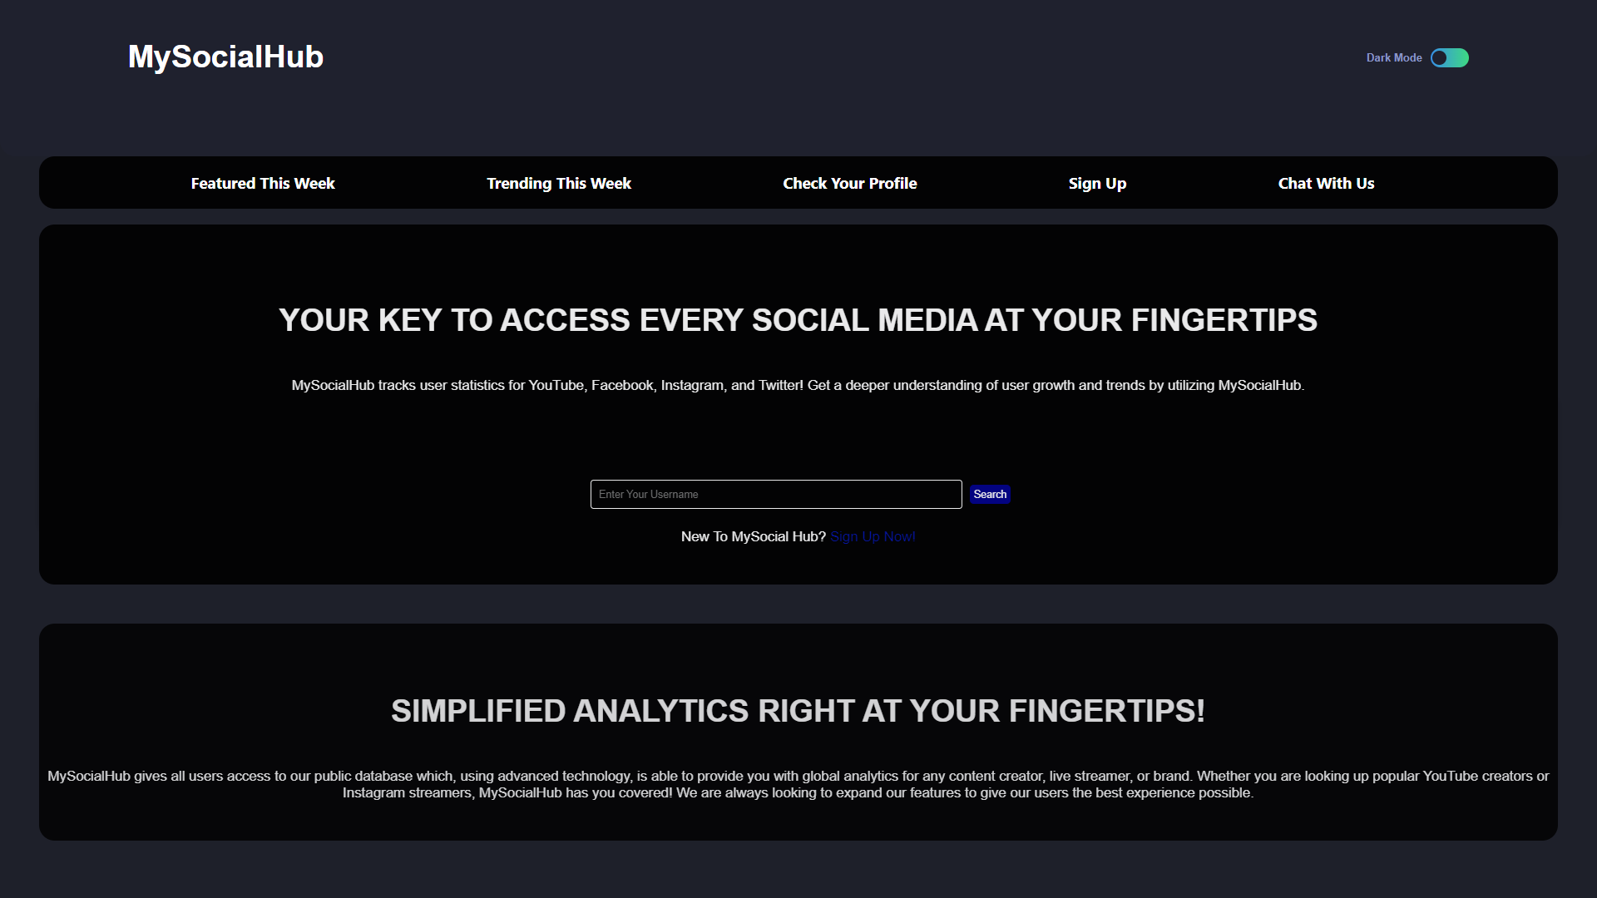
Project Highlights

Slide 8
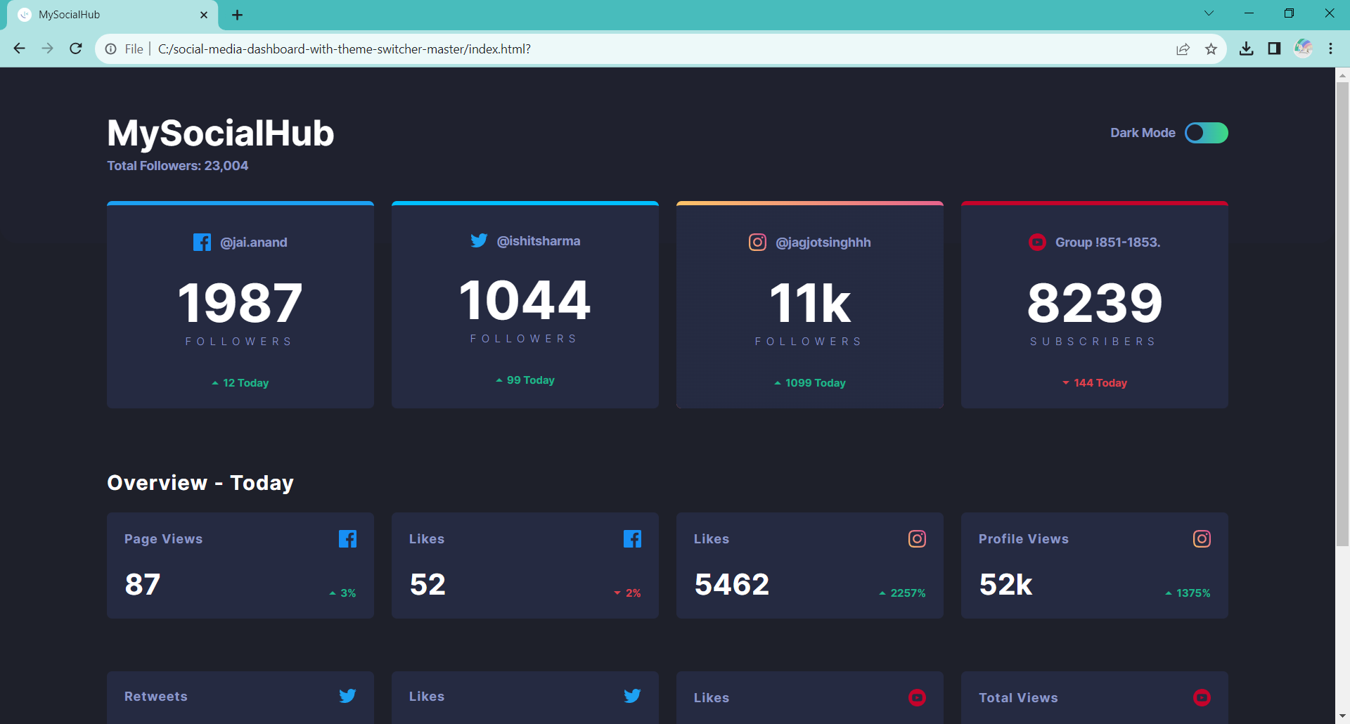
Project Highlights:

Slide 9
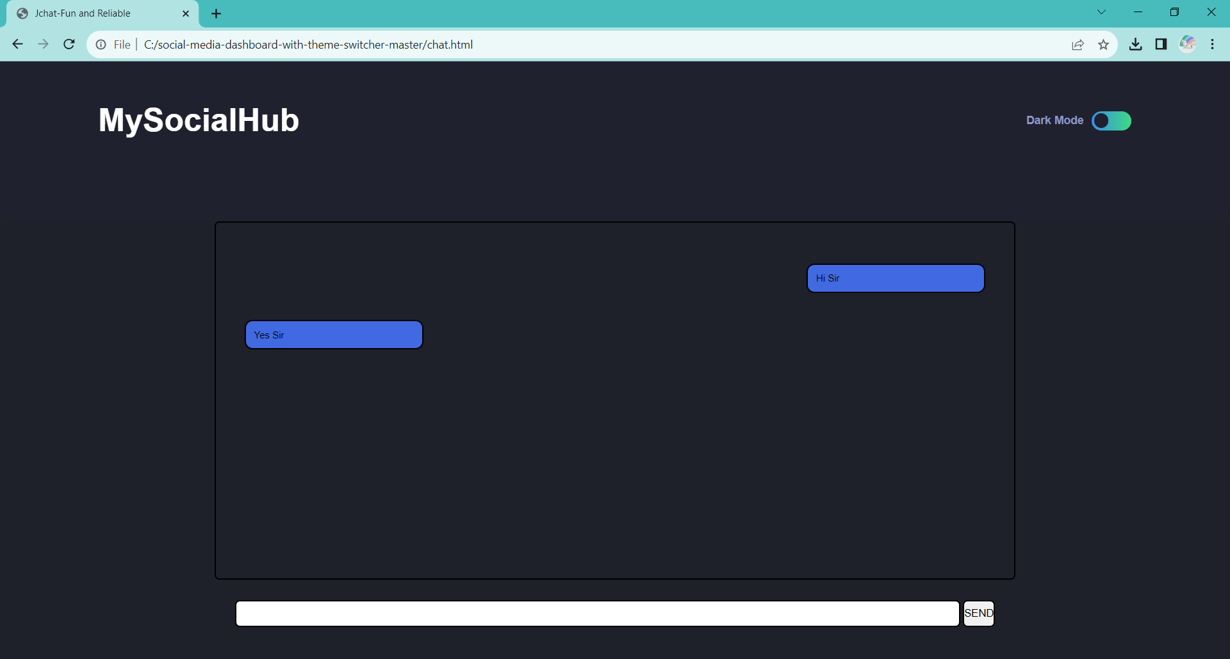
Project Highlights:

Slide 10
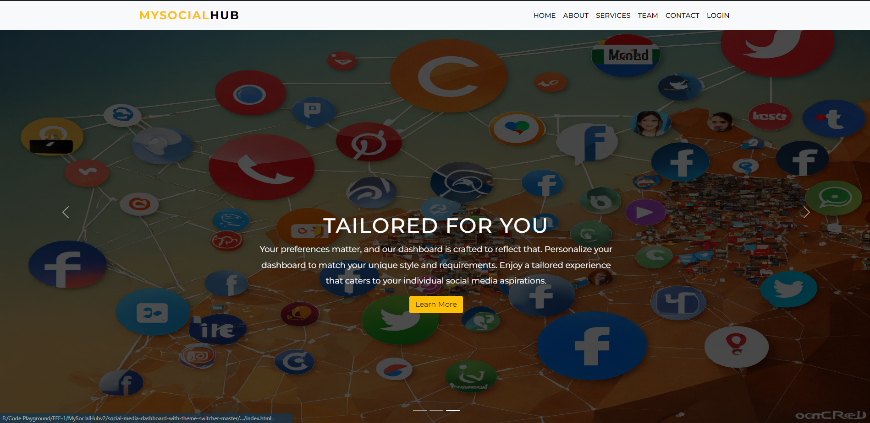
Project Highlights:

Slide 11
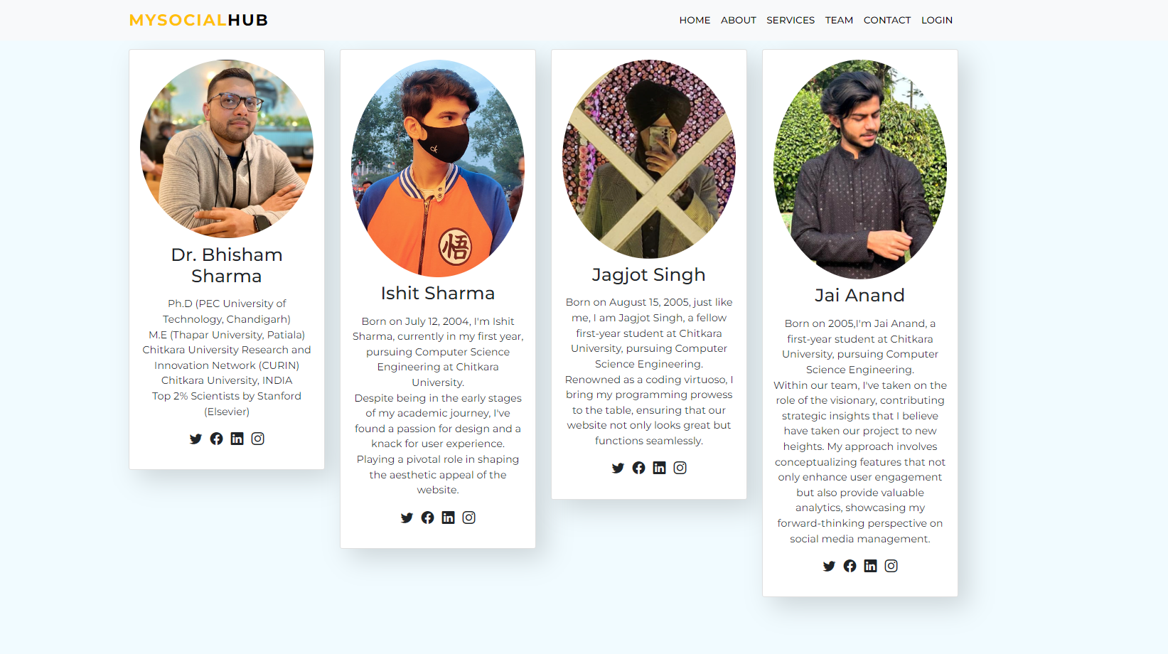
Project Highlights:

Slide 12
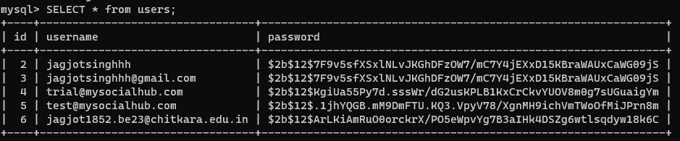
Project Highlights:

Slide 13
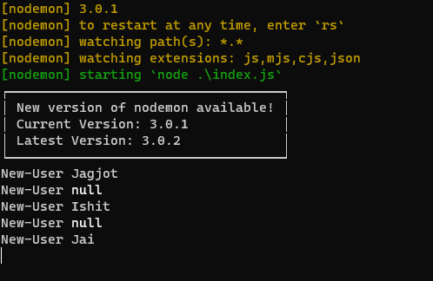
Project Highlights:

Slide 14
Bonus Feature(optional)
• Businesses can interact with certain profile for promotion.
• User can get direct notifications social from media platform itself.
• Dark Mode
• Trending highlights can be fetched.

Slide 15
Conclusion
In conclusion, the design and development of a Social Media Dashboard offers a tremendous opportunity to delve into the world of web development and user experience design. This beginner-level project allows aspiring developers to put their knowledge of HTML, CSS, and JavaScript .
In summary, our Social Media Dashboard project is meticulously crafted to streamline users' social media management. With essential features like social media tracking and comprehensive analytics reports, our goal is to empower users to make well-informed decisions regarding their online presence. We are dedicated to continuously improving the user experience, taking into account user feedback, and exploring future possibilities like AI integration and enhanced security, all aimed at enhancing users' social well-being.
All in all, this project can serve as a solid foundation for the development of a fully functional Social Media Dashboard. It has the potential to inspire learners to explore new horizons in web development and design, and to create innovative solutions for simplifying the complexities of social media management.

Slide 16
References/Links used
The following references were consulted in the development of this project:
https://socialblade.com
https://github.com
https://getbootstrap.com
https://www.w3schools.com
https://chat.openai.com

Slide 17


